Slide 1

NEEDATICKET
CONCERT TICKETS
Notes:
To change the image on this slide, select the picture and delete it. Then click the Pictures icon in the placeholder to insert your own image.

Slide 2
Ziel
Ticket-Verkaufsplattform mit schnellem Preisvergleich
Konzerte, Proben und Festivals
Käuferapp und Verkäuferprogramm
Bearer Authentifizierung und API Key am Webservice
Oracle SQL Datenbank

Slide 3
Arbeitsteilung
Berisa – Android App? | Java App
Blaschke – Database | Webservices
Judth – Database | Webservices
Winkler – Android App | Project Management

Slide 4
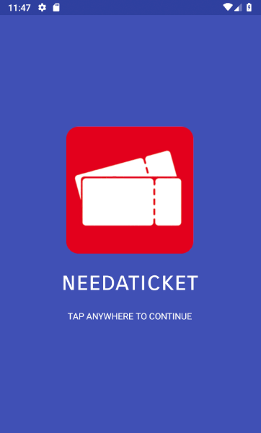
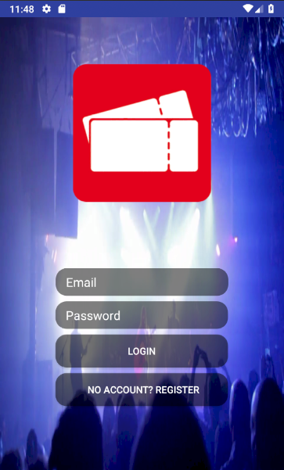
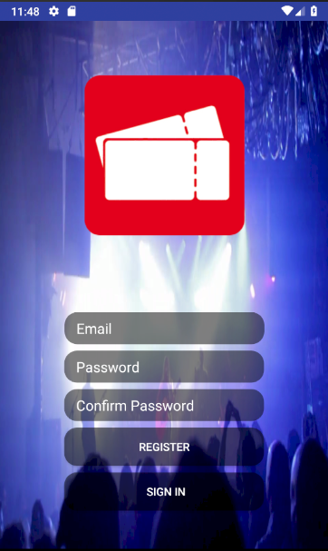
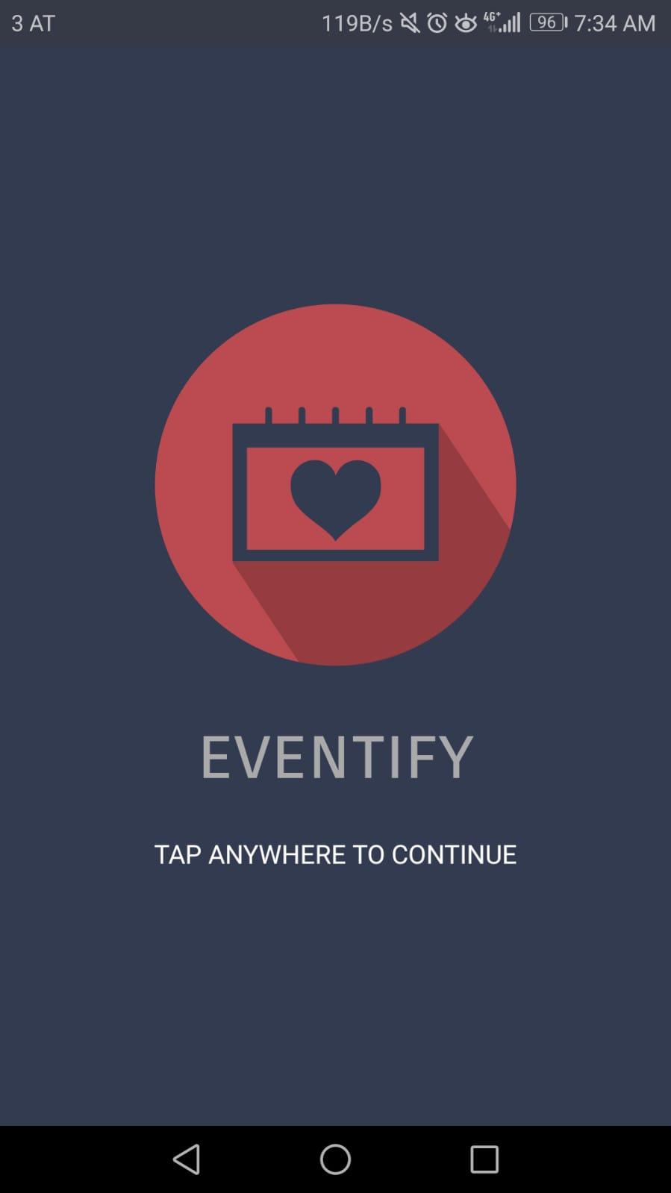
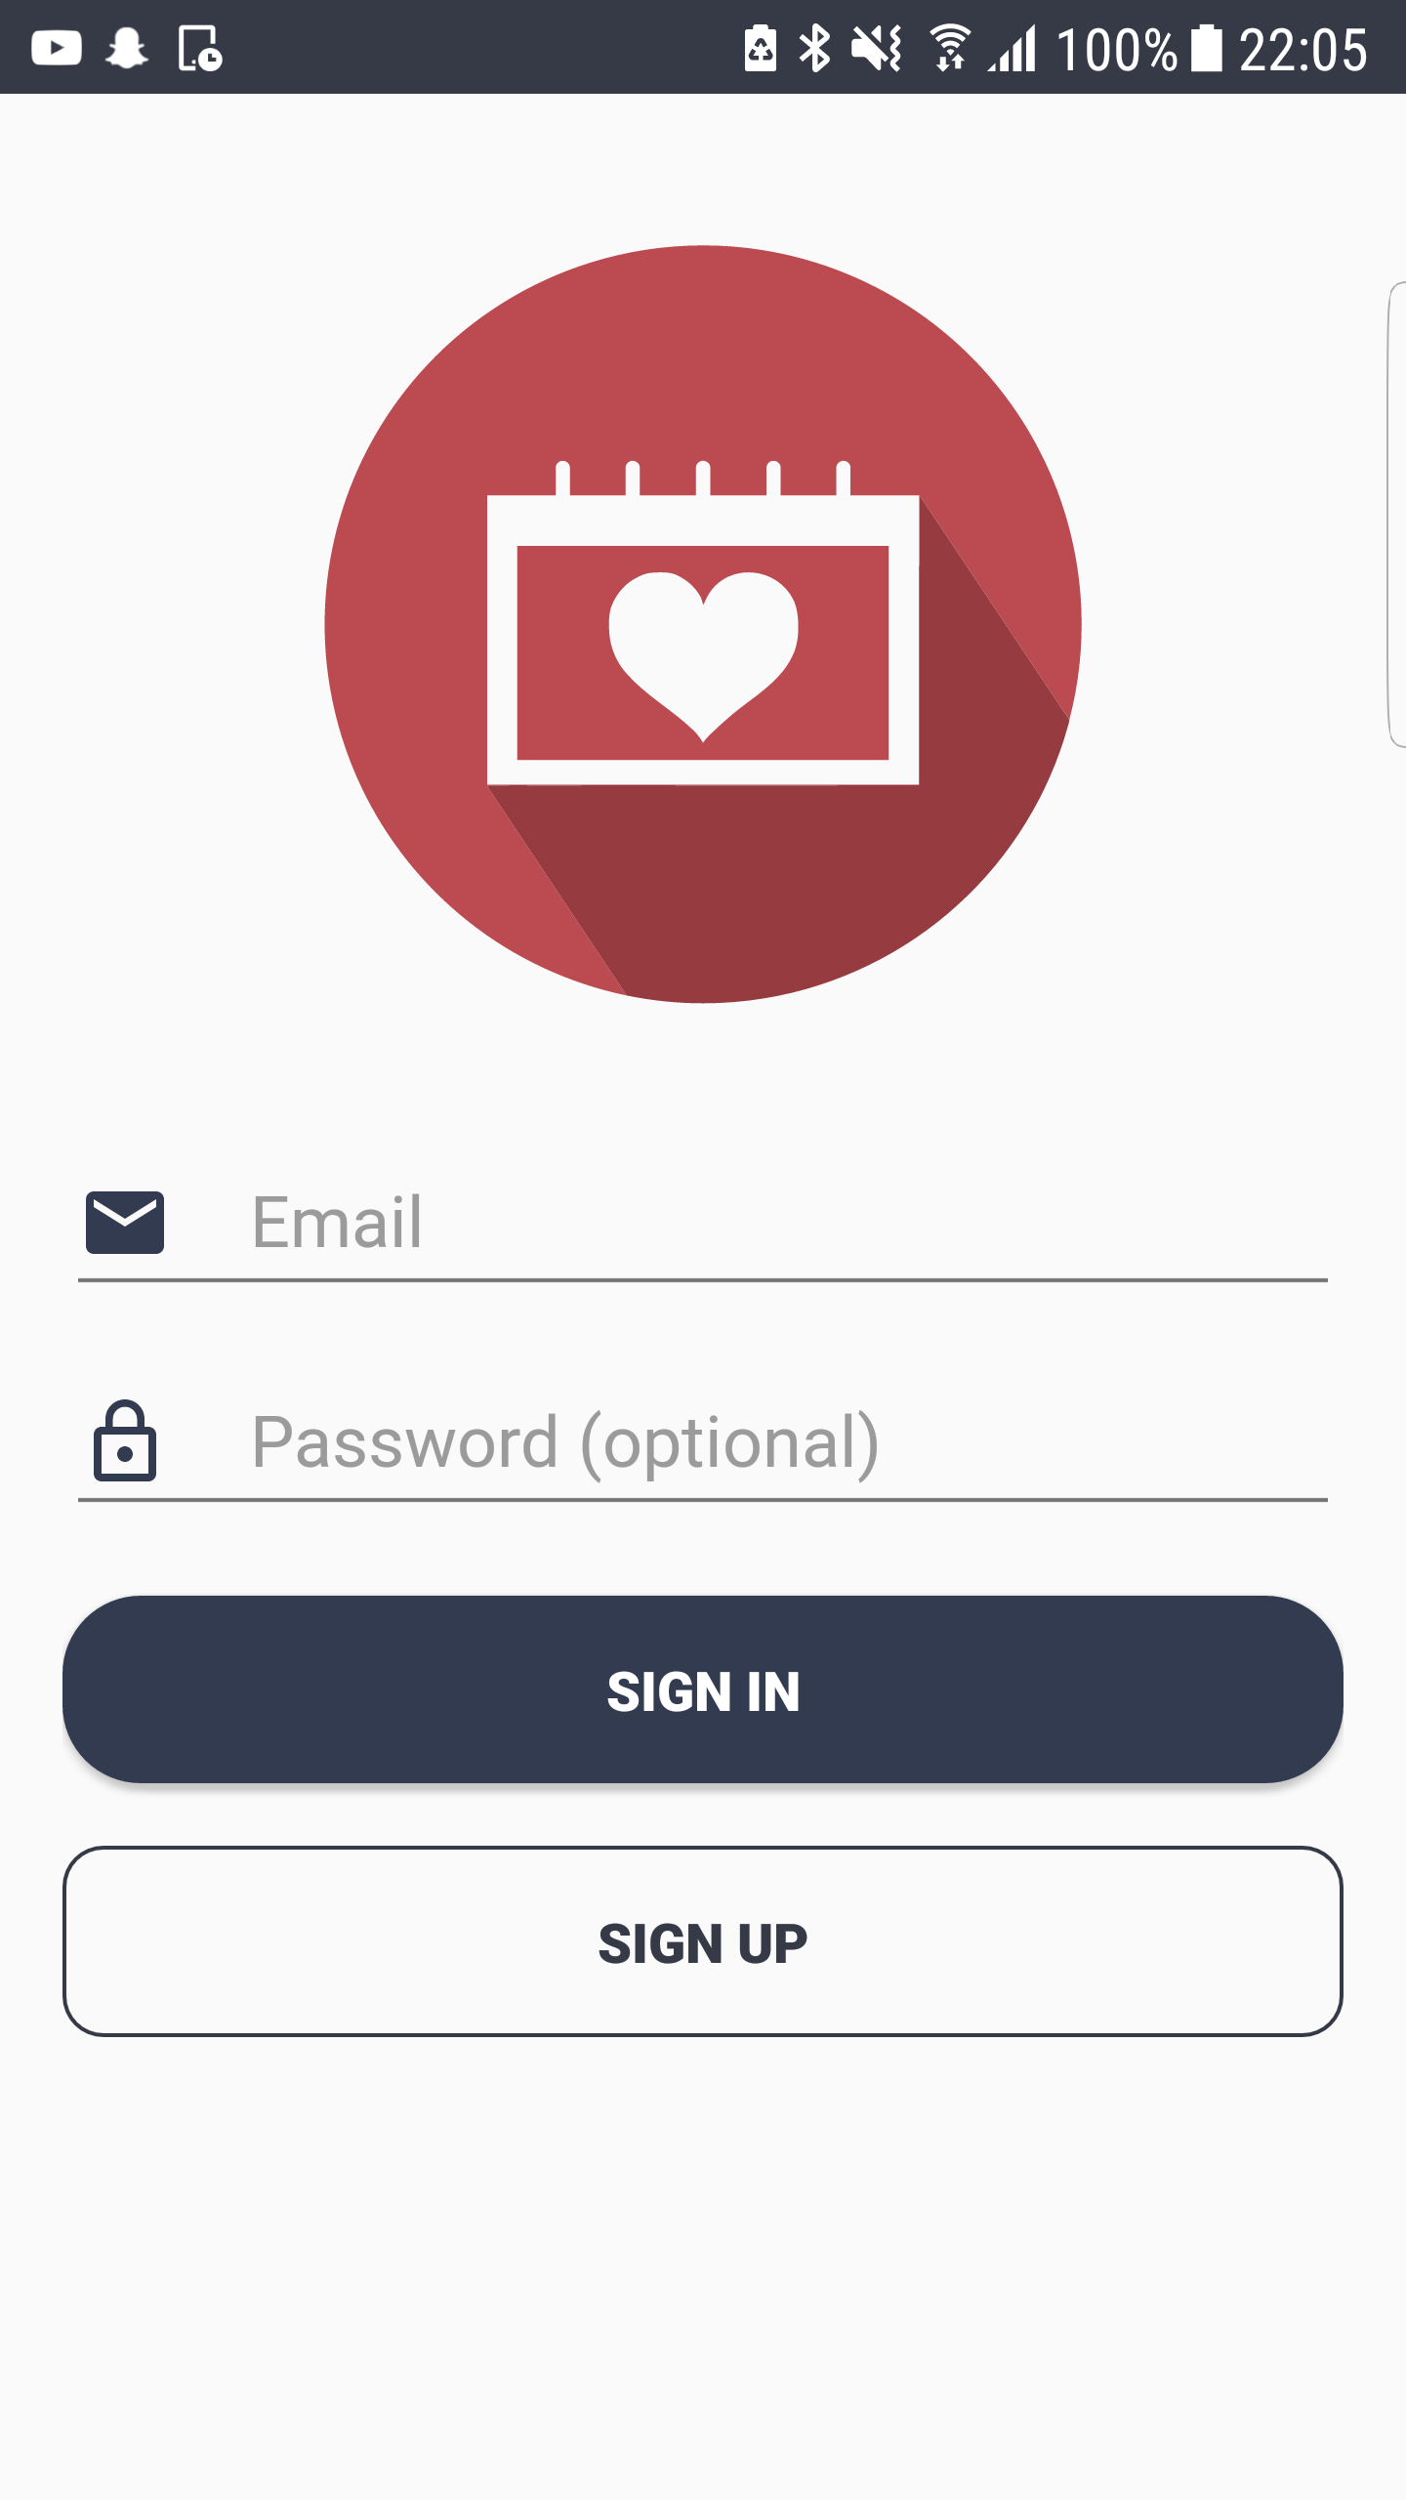
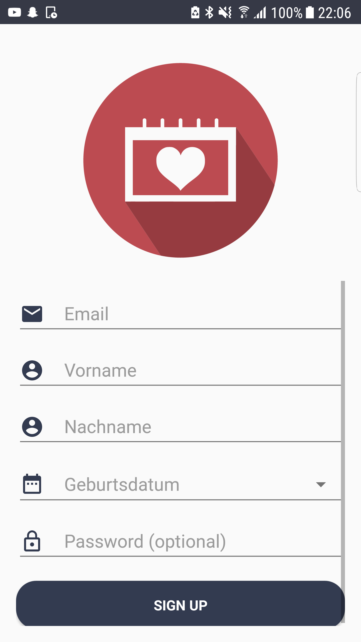
Android App
Welcome Screen
Login
Register

Slide 5
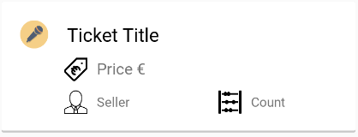
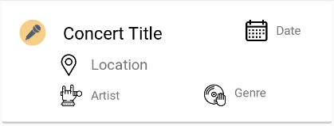
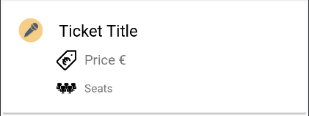
Android App
Tickets to purchase
Concerts
MyTickets

Slide 6
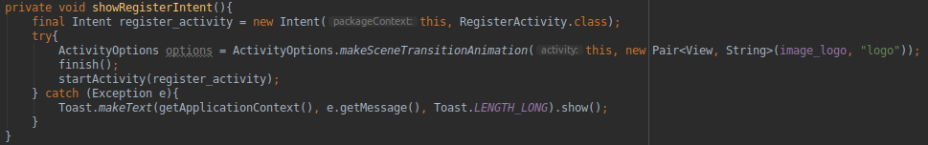
Android App
Activity Stacking

Slide 7
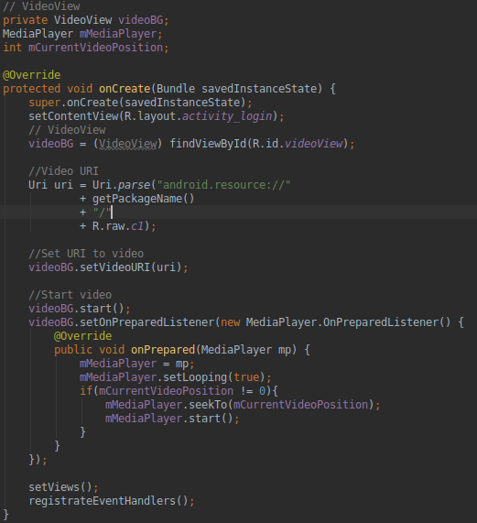

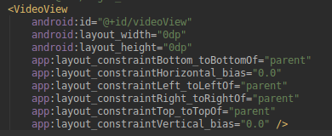
Android App
Video Background

Slide 8
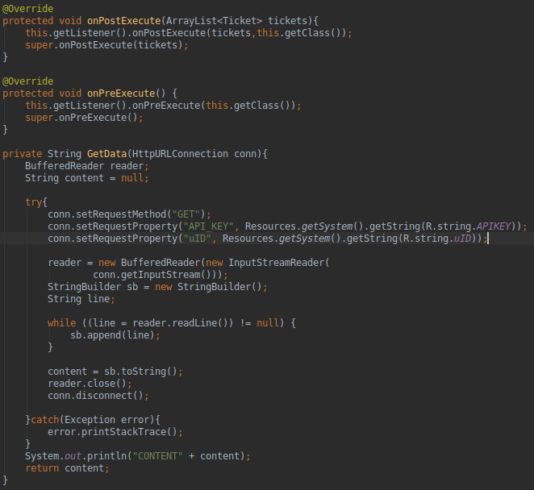

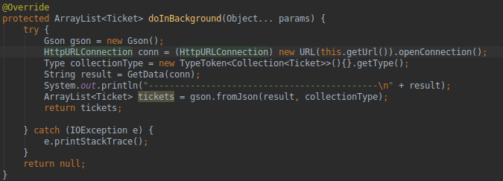
Android App
Webservice Calls

Slide 9
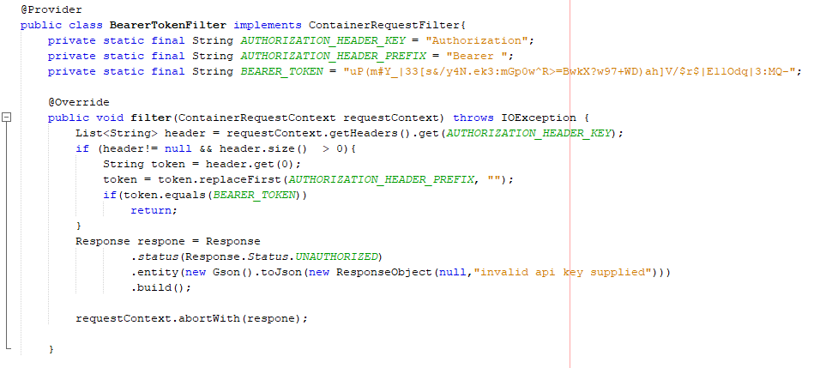
Webservice
Container Request Filter
Zur Authentifizierung

Slide 10
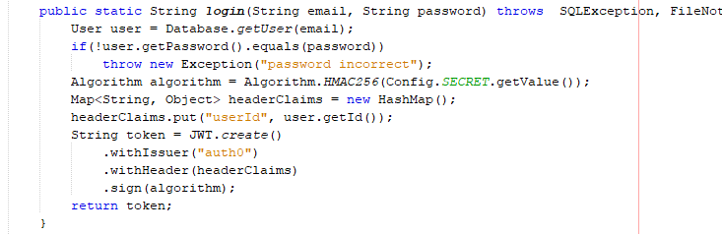
Webservice
JSON Web Tokens

Slide 11
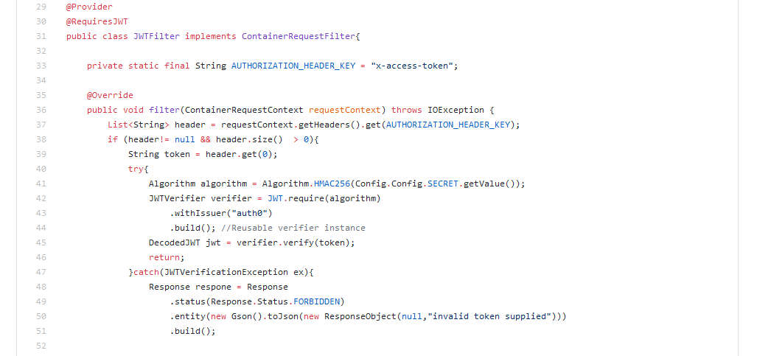
Webservice
JSON Web Tokens

Slide 12
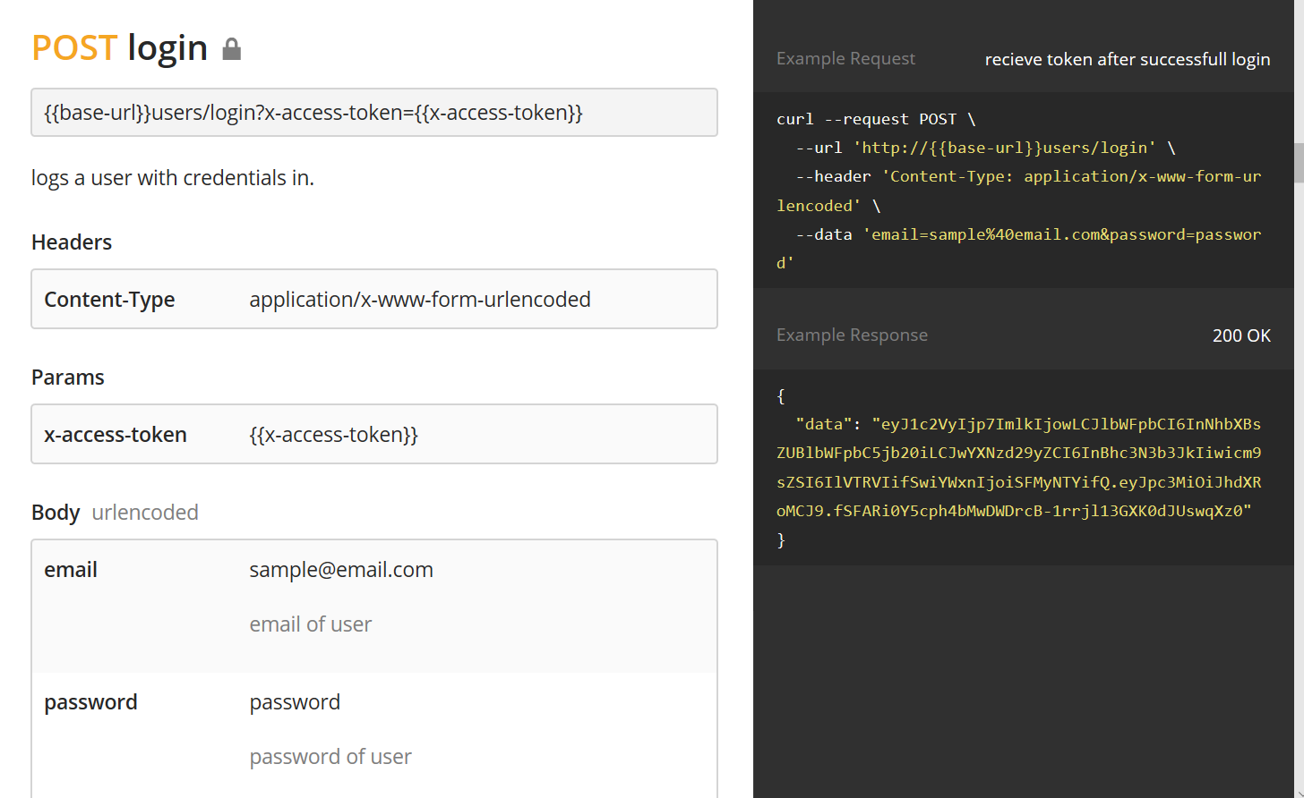
Webservice
Dokumentation

Slide 13
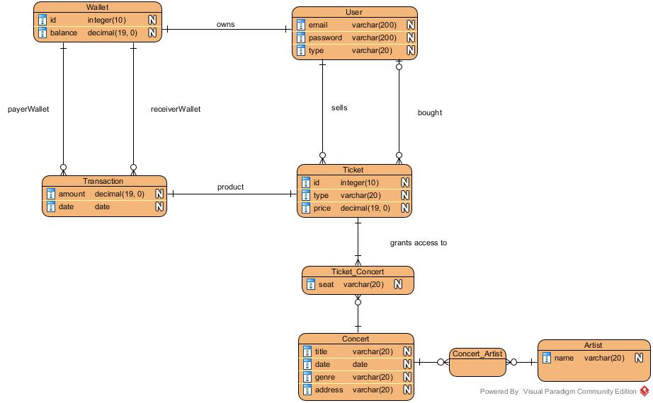
Webservice
Database

Slide 14
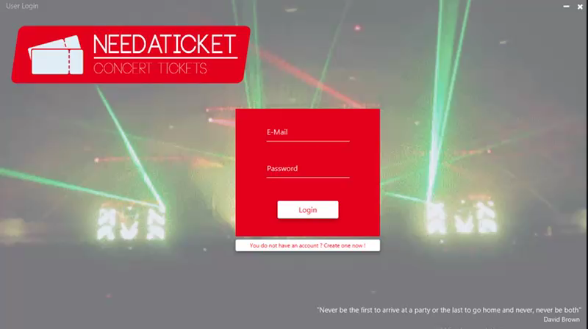
Java App
Login / Register (Error – Showcase)

Slide 15
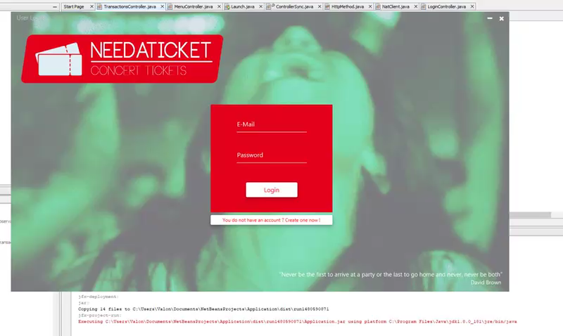
Java App
Cool Transition :P

Slide 16
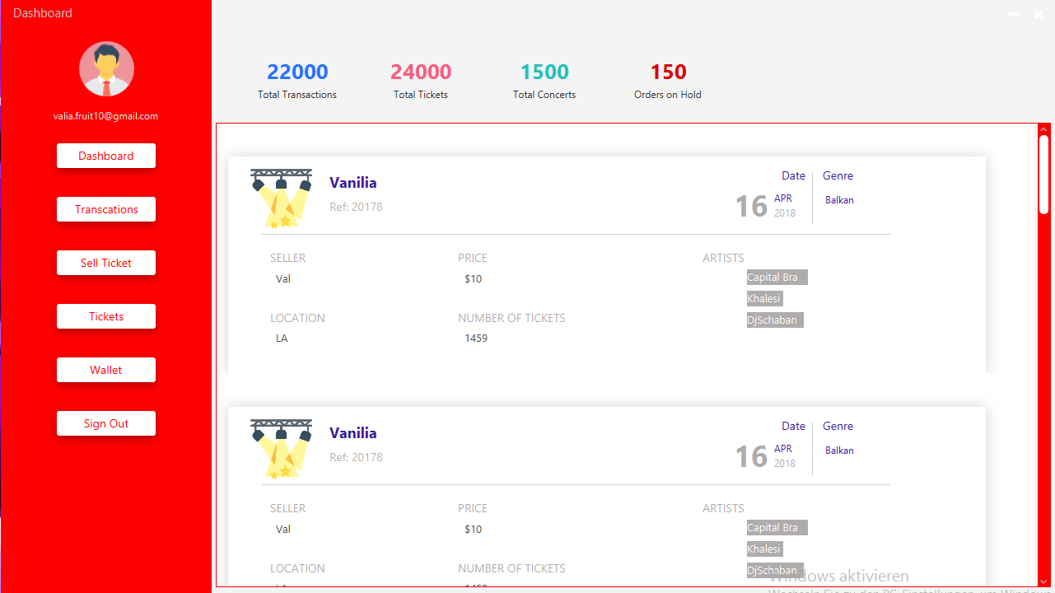
Java App
Tickets

Slide 17
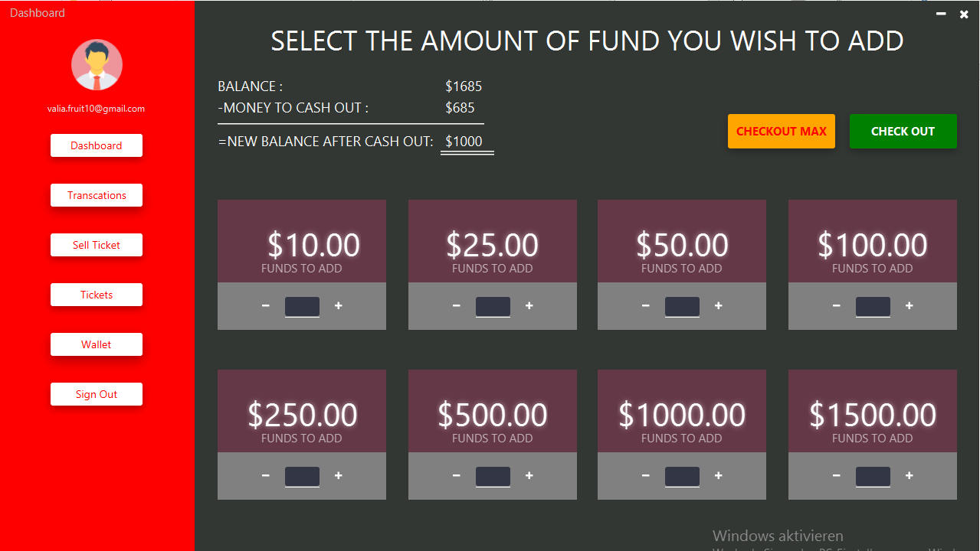
Java App
Wallet

Slide 18
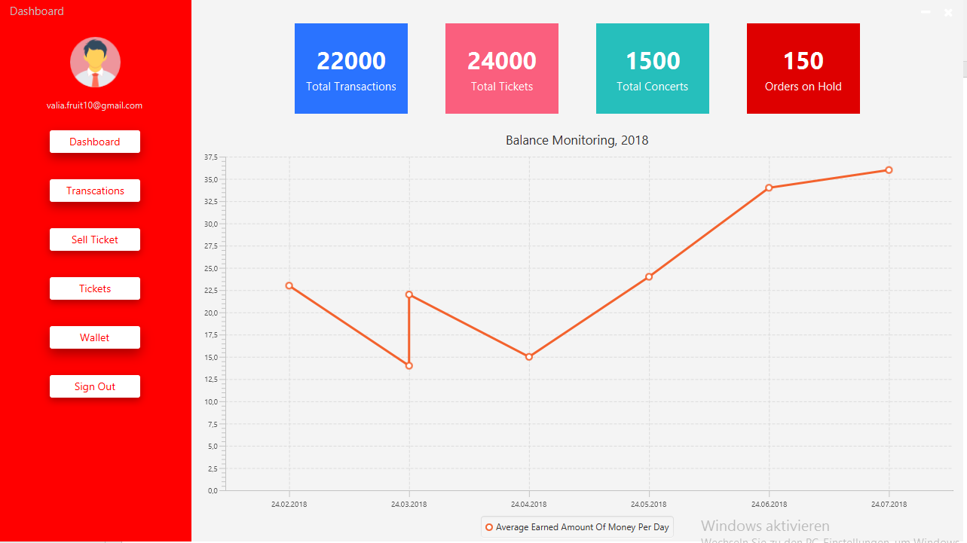
Java App
Dashboard

Slide 19
NEEDATICKET
CONCERT TICKETS
Vielen Dank für Ihre Aufmerksamkeit!
Notes:
To change the image on this slide, select the picture and delete it. Then click the Pictures icon in the placeholder to insert your own image.

